Slide 1
Google Play Store Apps
A DATA SCIENCE ANALYSIS
Start!

Slide 2
Introduction to the Kaggle Dataset
1
The Kaggle Dataset provides a comprehensive analysis of the apps downloaded on devices as well as user experiences.
Data Analysis is used to enhance the app performance of application based on the feedback given by users.
2
To diagnose the root causes of data problems, such as data quality issues or unusual data patterns.
3
4

Slide 3
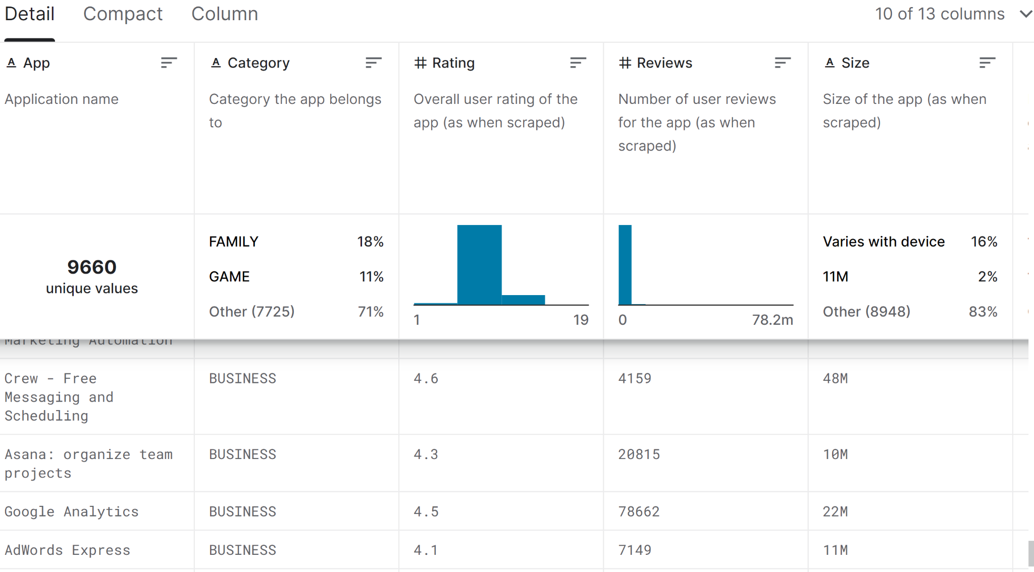
Data Overview
1
The data set has
-9660 unique values
-13 columns
2
3
4

Slide 4
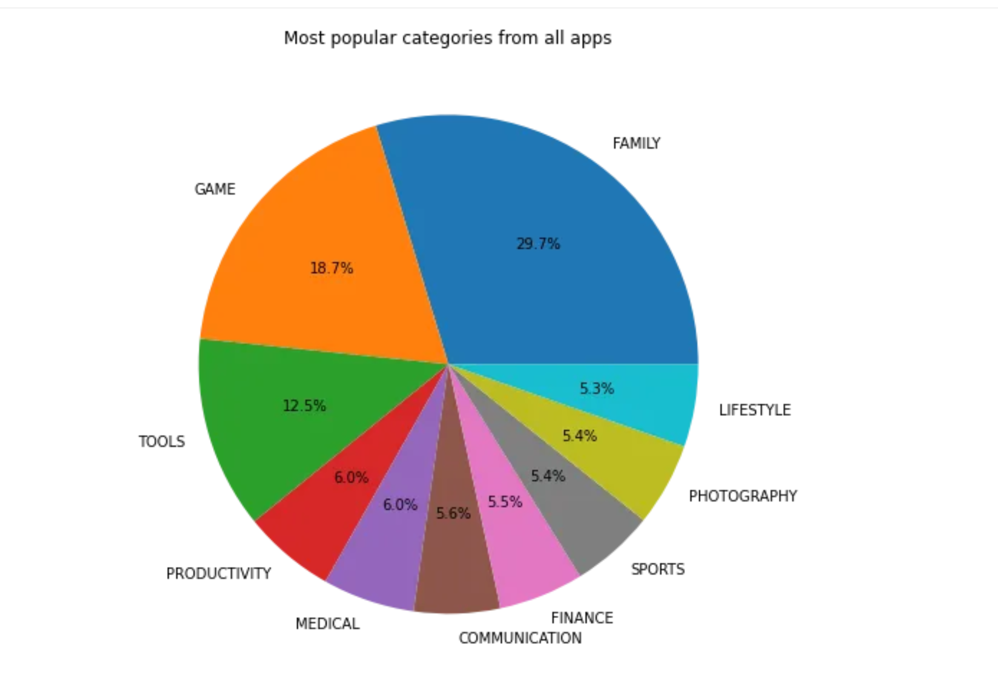
App Category Analysis
1
It can be seen from Figure 2 that the most popular category is “Family”, which takes roughly a third of the marketplace. “Game” and “Tools” take second and third place in popularity, constituting 18.7% and 12.5% of the marketplace, respectively.
2
3
4

Slide 5
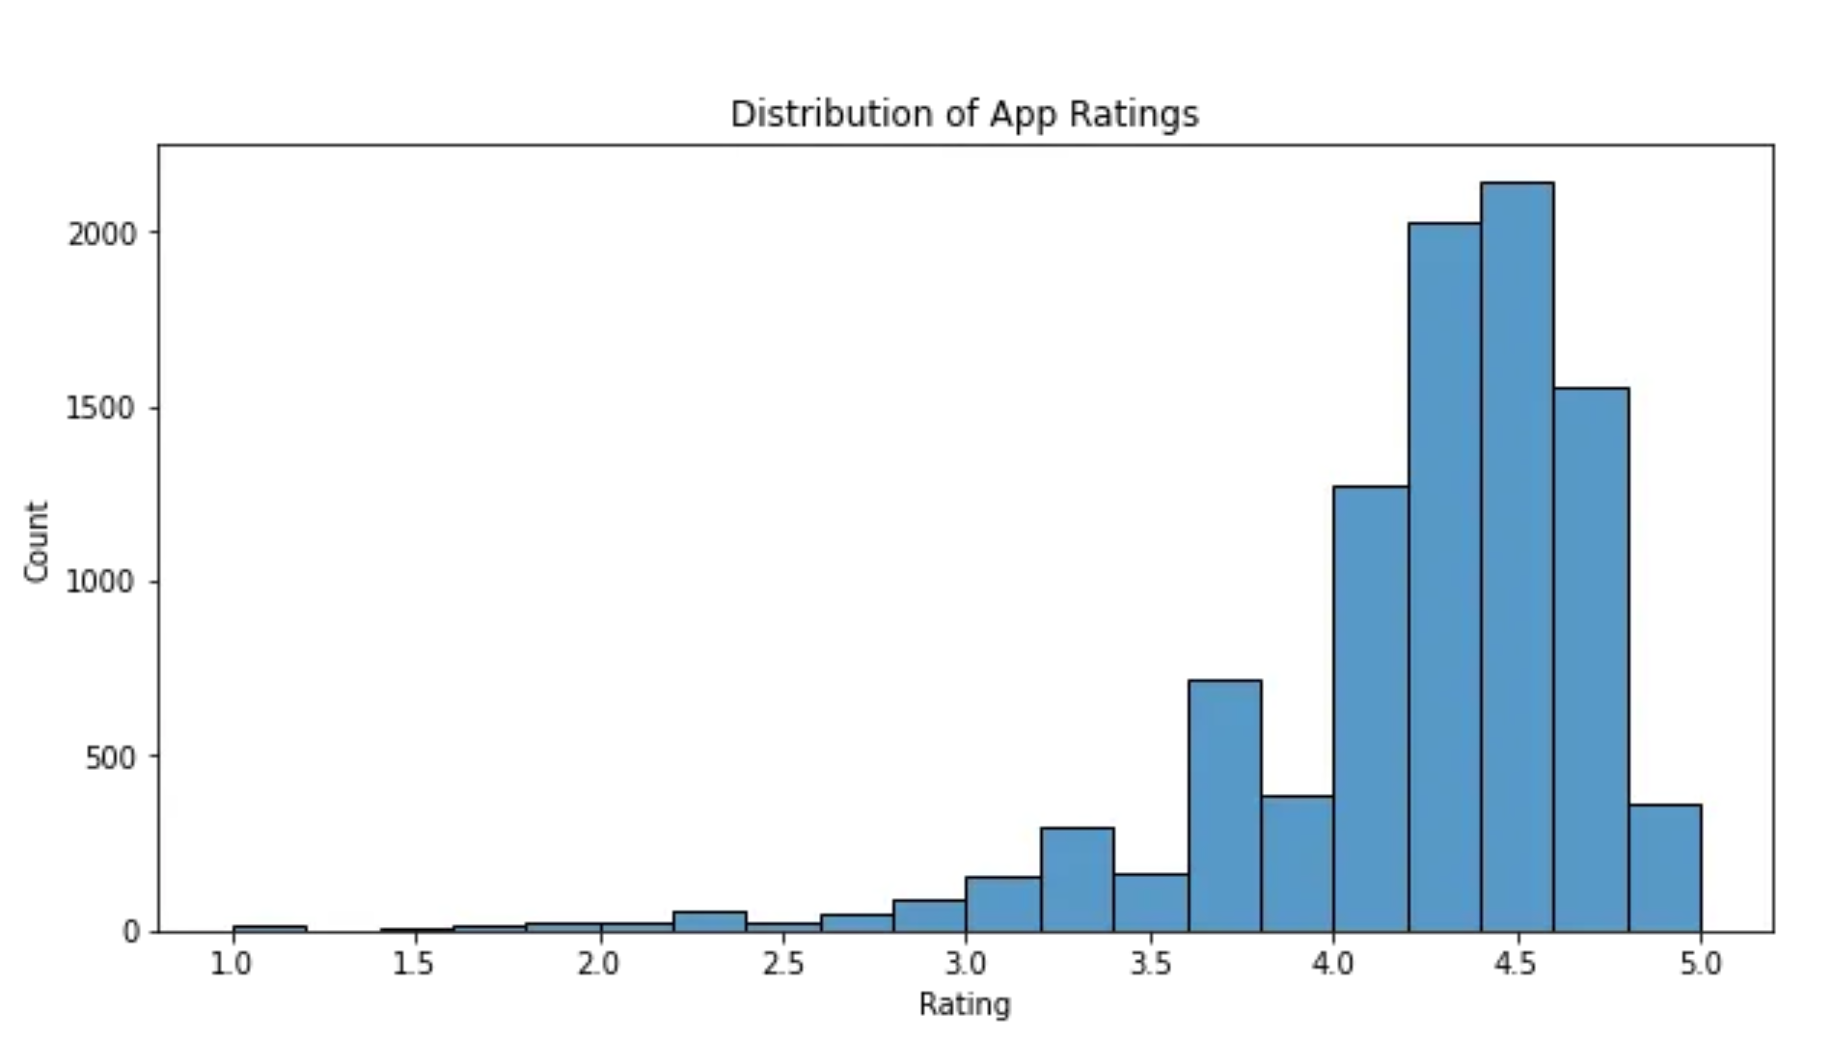
App Ratings Analysis
1
The x-axis represents the rating, ranging from 1 to 5, while the y-axis shows the number of apps that fall into each rating bin.
From the plot, it is apparent that a majority of apps have high ratings, roughly between 4 and 5. This indicates that users tend to rate apps positively in the Google Play Store.
2
3
4

